Slide 1


Professional Capabilities for a Digital World
School of Business, Law and Entrepreneurship
INF20028
Presenter: Stuart McLoughlin
Online Learning Materiel: The Skills Framework for the Information Age
Where our skills fit into the Global ICT ecosystem

Slide 2
Objectives
Introduce the concept of the Skills Framework for the Information Age (SFIA)
Briefly discuss skills framework and transferable skills
Describe the process of governing of SFIA and the current version and highlight an issue with backwards compatibility
Summarise the key characteristics of SFIA
Identify some of the common key skill views of SFIA
Describe the relationship between Professional & Organisational Roles & Levels of Responsibility
Discuss how experience is at the core/heart of SFIA
Briefly look at the 70-20-10 Model for Learning in the Workplace
Provide an opportunity for a 1-Minute Paper
Identify areas for further exploration in your own time

Slide 3
ULOs focused on this week
This week’s learning material will directly relate/focus on ULOs: 2 & 3
1. Develop and present a resolved project outcome which synthesises an understanding of ethical and socio-technical challenges faced by an ICT professional
2. Evaluate the role of standards, codes of conduct and legislative/regulatory obligations on the level of professionalism of the ICT industry
3. Review the roles and responsibilities of ICT professionals in organisations and society from a range of perspectives such as work-life balance, mentoring and life-long learning
4. Communicate effectively as a professional and function as an effective leader or member of a team

Slide 4
Skills Framework for the Information Age (SFIA)
SFIA describes skills and competencies required by professionals in roles involved in information and communication technologies, digital transformation and software engineering.
The SFIA has been developed by the SFIA Foundation
https://www.sfia-online.org/en
SFIA 7 is the current version
The Framework is not backwards compatible

Slide 5
Skills Framework for the Information Age (SFIA)
SFIA is straightforward, generic and universally applicable.
SFIA is an experience-based framework.
SFIA defines levels of responsibility and skills.
SFIA defines the essence of skills.
SFIA provides an integrated view of competency.
SFIA is independent of technology and approach.
SFIA is updated by real practitioners from the international user base.
SFIA does not assume or recommend specific organisation structures, job or role designs.

Slide 6
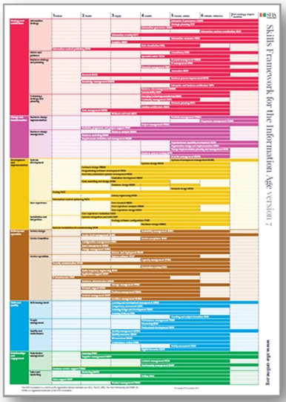
SFIA /
https://sfia-online.org/en/tools-and-resources/sfia-views
SFIA is designed to be flexible. These views of SFIA provide a quick-start list of the SFIA skills which are most relevant to a selection of professional disciplines.
Digital transformation skills view
DevOps skills view
Big data/Data science skills view
Software engineering skills view
Information and cyber security
Agile skills view - under development
SFIA is not competing with bodies of knowledge such as BABOK or PMBOK but actively promoting their importance and helping individuals and organisations understand how knowledge, skills and competency fit together

Slide 7
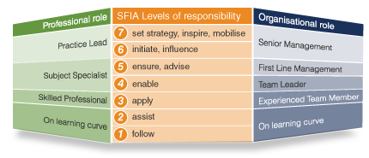
SFIA
Professional & Organisational Roles
Levels of Responsibility

Slide 8
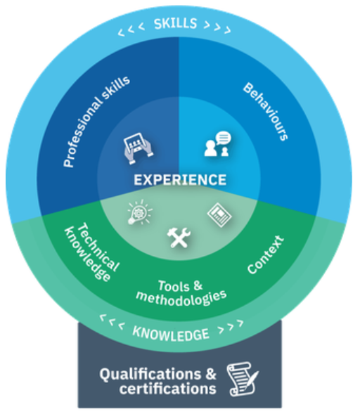
SFIA /

Slide 9
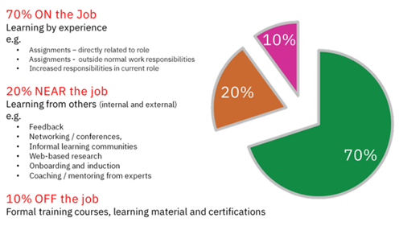
SFIA /
70-20-10 Model for Learning in the Workplace

Slide 10
SFIA /
Steps for doing a Self-Assessment
Have a clear purpose
Preparation
Assess the Level of Responsibility
Select the SFIA skill to assess
Assess the SFIA skills
Record work experience to support the assessment
Review and Reflect

Slide 11
SFIA
Certification
The SFIA Foundation operates two types of accreditation – for individuals and for companies.
Foundational level
Not an accreditation per-se but intended as an early 'stepping-stone' towards accreditation at a higher level or to recognise SFIA awareness within an organisation.
SFIA Accredited Consultants
SFIA Accredited Practitioners
Coming soon: A scheme for the assessment of an individual's skills profile is being developed and will be published in due course.
More details on certification can be found here: https://sfia-online.org/en/get-accredited

Slide 12


Slide 13

What is SFIA?

Slide 14

Have we achieved our Objectives
Introduced the concept of the Skills Framework for the Information Age (SFIA)
Briefly discussed skills framework and transferable skills
Described the process of governing of SFIA and the current version and highlight an issue with backwards compatibility
Summarised the key characteristics of SFIA
Identified some of the common key skill views of SFIA
Described the relationship between Professional & Organisational Roles & Levels of Responsibility
Discussed how experience is at the core/heart of SFIA
Briefly looked at the 70-20-10 Model for Learning in the Workplace
Provided an opportunity for a 1-Minute Paper
Identified areas for further exploration in your own time

Slide 15
References
Andrews, J & Higson, H 2008, Graduate employability, “soft skills” versus “hard”
business knowledge: A European study, Higher Education in Europe, 33(4), pp. 411–422.
Brown, J 2020, An examination of the Skills Framework for the Information Age (SFIA)
version 7, International Journal of Information Management, 51, pp.
Eisner, S 2010, Grave new world? Workplace skills for today’s college graduates,
American Journal of Business Education, 3(9), pp. 27–50.
Raybould, J & Sheedy, V 2005, Are graduates equipped with the right skills in the
employability stakes? Industrial and commercial training, 37(5), pp. 259–263
Robles, M 2012, Executive perceptions of the top 10 soft skills needed in today’s workplace. Business Communication Quarterly, 75(4), pp. 453–465.

